Slide 1

Designing an Expert system for diagnosing Heart Disease 1.0

Slide 2
Agenda
Introduction
Software Project Proposal
Expected Deliverables
Software Requirement
Software Design
Software Testing
Software Development
Pre-recorded Demo
Software Tools
Risks vs Solutions
Team roles and responsibilities
Project learning outcomes
Project Management
References

Slide 3
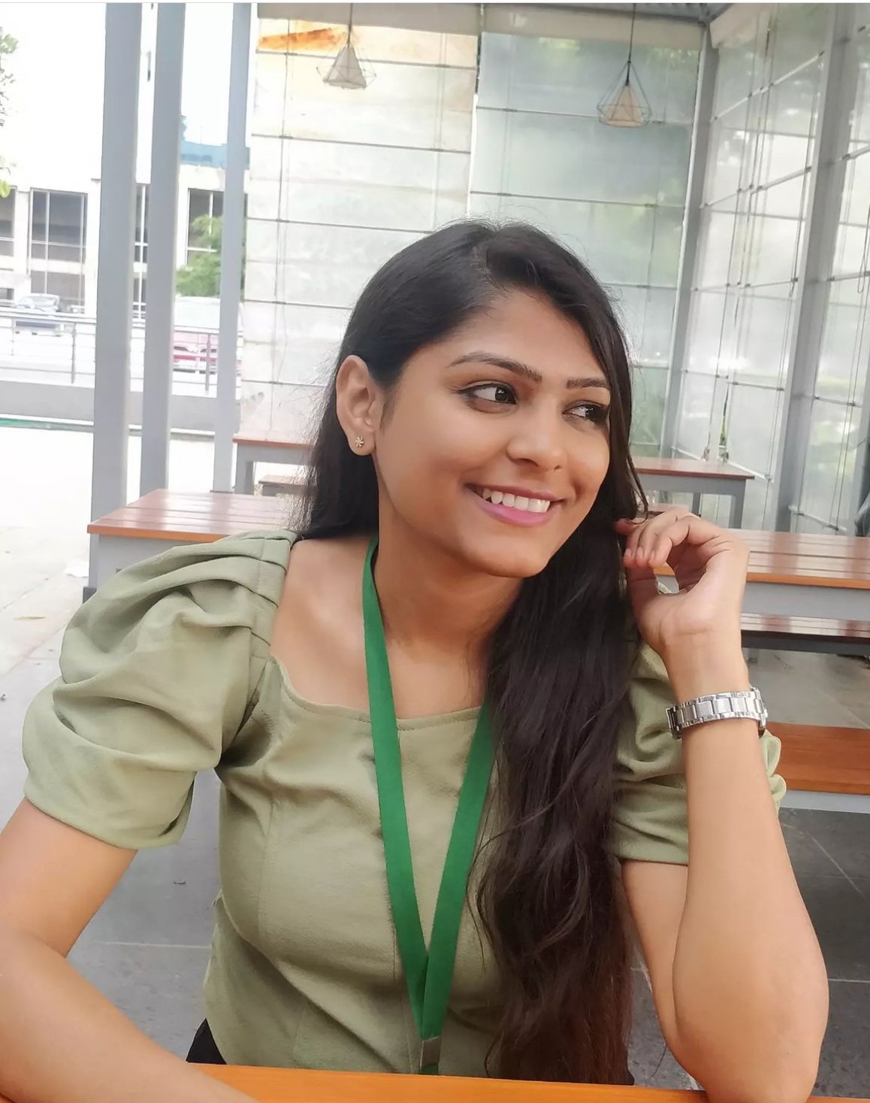



Team Members
PIC
Atharva Atre
Navyaprabha Rajappa
Chaitanya Nalluru
Sai Vikram Gurram

Slide 4
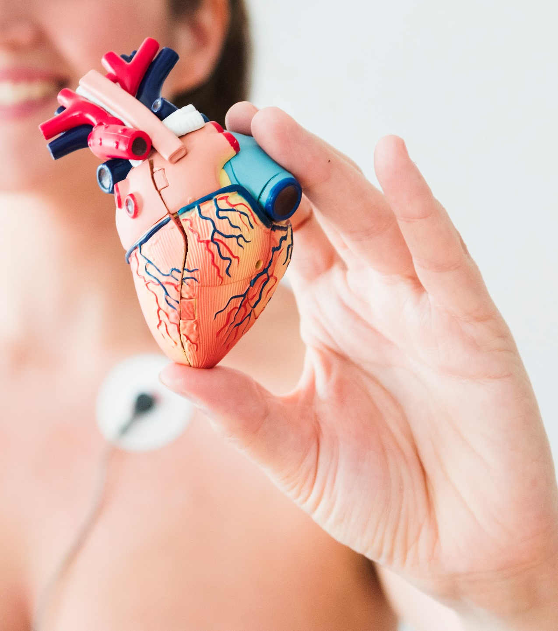
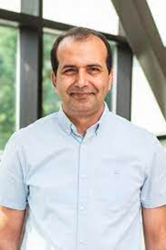
INTRODUCTION
The Expert System for Diagnosing Heart Disease is a project aimed at developing a web-based expert system that will assist healthcare professionals, common patient, particularly doctors and physicians, in diagnosing a wide range of heart diseases.
Client - Dr. Mohammadreza Hajiarbabi
Assistant Professor of Computer Science at PFW

Slide 5
SOFTWARE PROJECT PROPOSAL
Objective:
Develop an intuitive system using machine learning to calculate the probability of heart disease .
Approach:
Data Collection: Assemble a diverse dataset emphasizing symptoms.
Feature Engineering: Identify key features for accurate probability calculation and diagnosis.
Model Development: Implement Random Forest and XGBoost for precise probability assessment and diagnosis.
Integration: Combine the machine learning model with the user interface for seamless probability calculation and diagnosis.
Testing and Evaluation: Rigorously test the system's ability to provide accurate probabilities and diagnoses; fine-tune for optimal performance.

Slide 6
Expected Deliverables:
Comprehensive dataset emphasizing symptoms, X-ray data, and corresponding diagnoses.
Feature-engineered dataset optimized for probability calculation and diagnosis accuracy.
User-friendly interface allowing personalized input for probability assessment and diagnosis.
Integrated expert system providing real-time probability and accurate heart disease diagnoses.
Evaluation report with performance metrics focusing on probability accuracy and diagnostic precision.

Slide 7
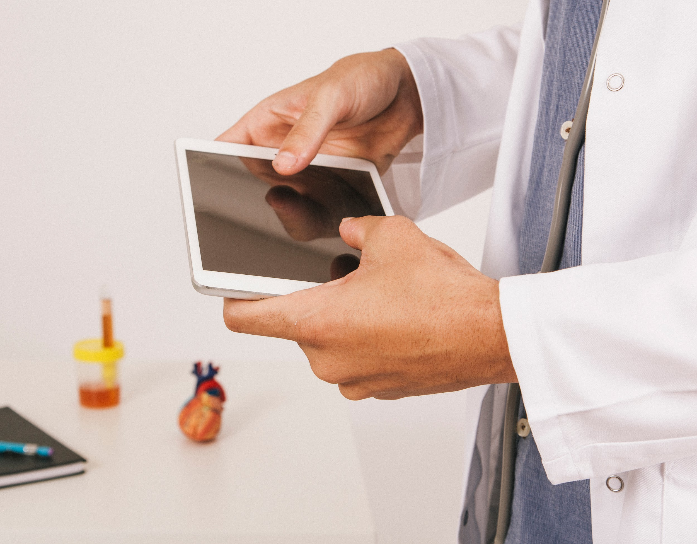
SOFTWARE REQUIREMENTS
Functional Requirements
User Interface (Web Interface):
User Registration (Patient,Doctor)
Symptom Input (Patient)
Preliminary Diagnosis (Machine Learning Module)
Consultation (Doctor)

Slide 8

Future Scope for functional requirements and features:
Additional Tests (Doctor)
Final Diagnosis (Doctor)
System Maintenance (Administrator)

Slide 9
.
Performance
Reliability
Usability
Non-Functional Requirements

Slide 10
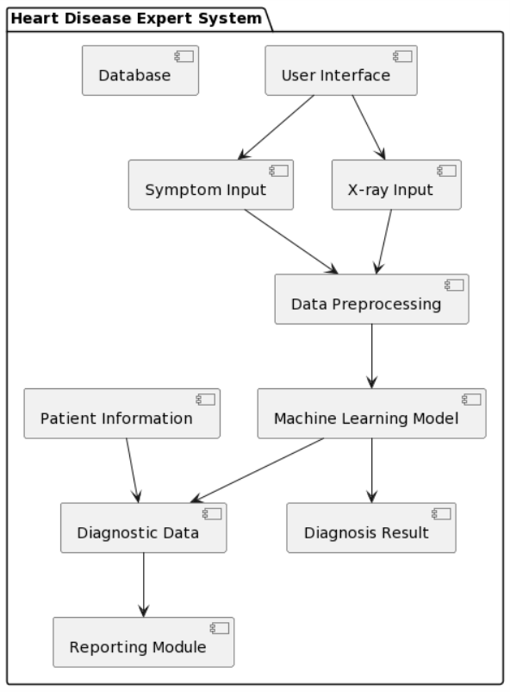
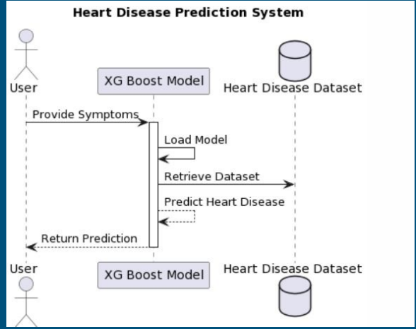
Design

Slide 11
Use Case | Test Case | Test data | Expected results | Review
Sign up | 1. Entry of Blank Name, Email and Password | User leaves the name field blank. | The system displays an error message indicating that the Name, Email field cannot be empty | Ensure that the system correctly handles cases where the user does not provide a Name or email and prompts them to enter the required information.
Validate Patient's Age Input | entry of Alphanumeric Characters in Age | User enters a combination of alphanumeric characters as the age | The system recognizes the input as invalid and not let the user input other than numbers. | Confirm that the system effectively identifies errors when the age input contains a mix of letters and numbers.
 | Successful Entry of Numeric Age | User enters a valid numeric age | The system accepts the numeric age without errors. | Confirm that the system correctly processes and accepts valid numeric age entries.
Testing:

Slide 12
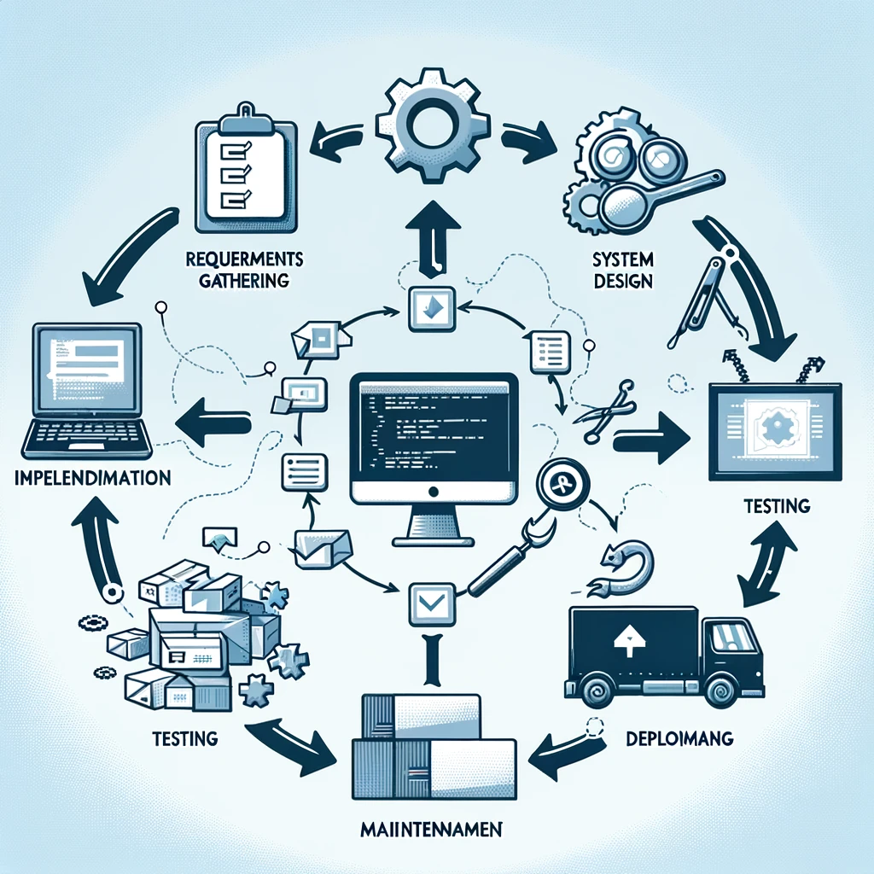
SOFTWARE DEVELOPMENT
Agile Methodology
Biweekly Sprints with 15 minutes standup meeting every Thursday.
Monthly Client Meeting to give progress update and get feedback.
Tech Stack Used - Python, Tensorflow, html, css, javascript
Unit Testing and Quality Assurance

Slide 13

Project demo

Slide 14

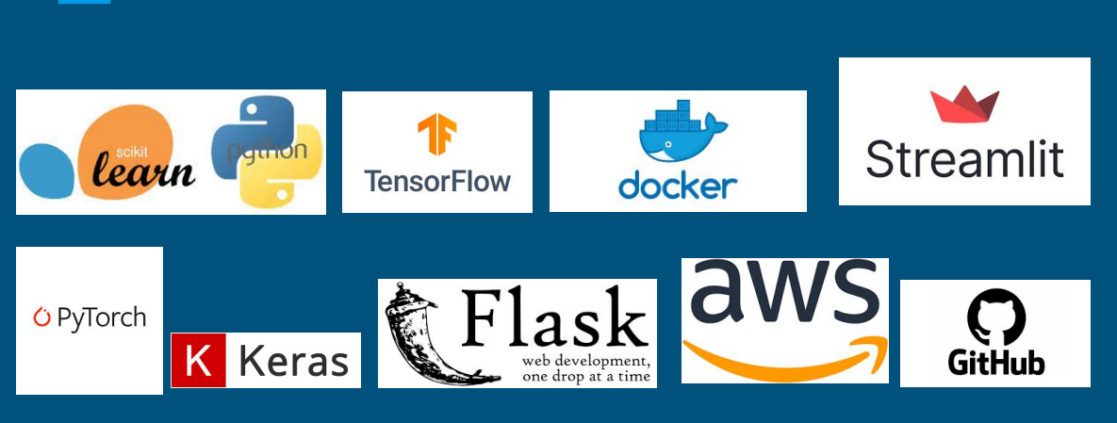
Tools and Development Environment

Slide 15
Risks vs solutions
Inaccurate Diagnosis
Model Accuracy Improvement
Sensitive Patient Data
Data Security
Integration Challenges
Integration Planning

Slide 16
Team roles and responsibilities
Atharva Atre
Sai vikram gurram
Navyaprabha Rajappa
Chaitanya Nalluru
Worked on AI model development and Integration of model result with the front end
Worked on the Prototype(Bubble.io),Design and Contributed in documentation
Worked on front end(Home,login,signup and profile), test cases,documentation, database and Backend, Deployment
Worked on front end input page, prediction page, contributed in test cases and documentation.

Slide 17
Project Learning outcomes
Collaborative Teamwork
Problem Solving
Software Development Skills
Project Management
Domain Knowledge
Communication Skills

Slide 18
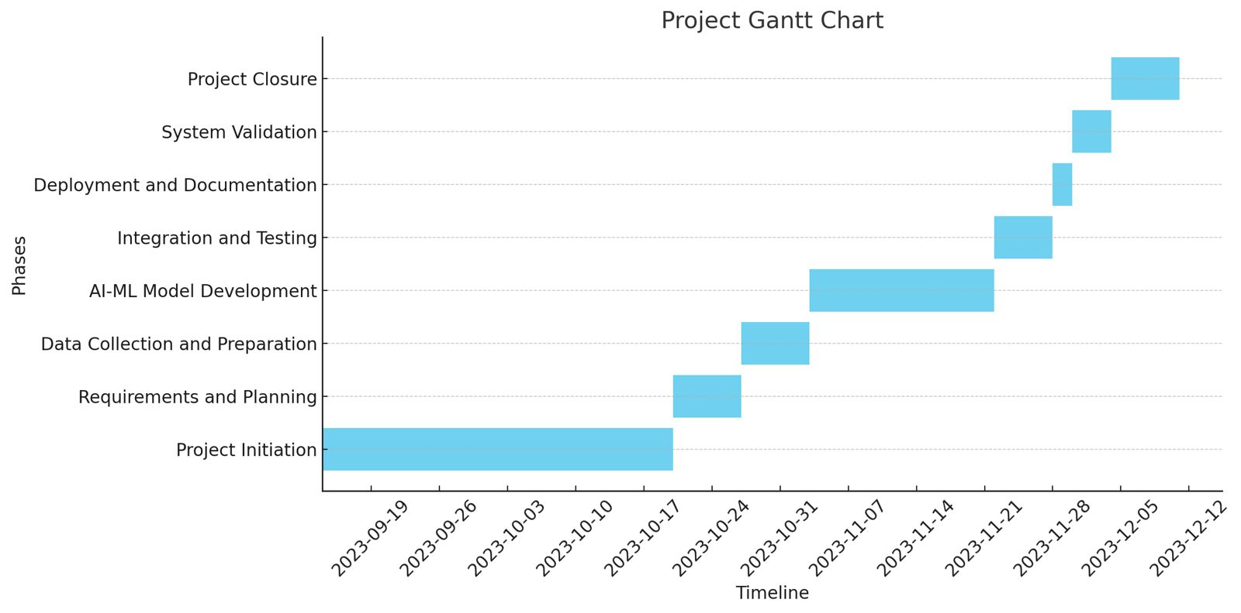
Project management

Slide 19

REFERENCES
https://link.springer.com/article/10.1007/s42979-023-01818-w
https://archive.ics.uci.edu/dataset/45/heart+disease
https://physionet.org/content/mitdb/1.0.0/
https://www.kaggle.com/datasets/aasheesh200/framingham-heart-study-dataset
https://physicsworld.com/a/deep-learning-model-uses-chest-x-rays-to-detect-heart-disease/

Slide 20
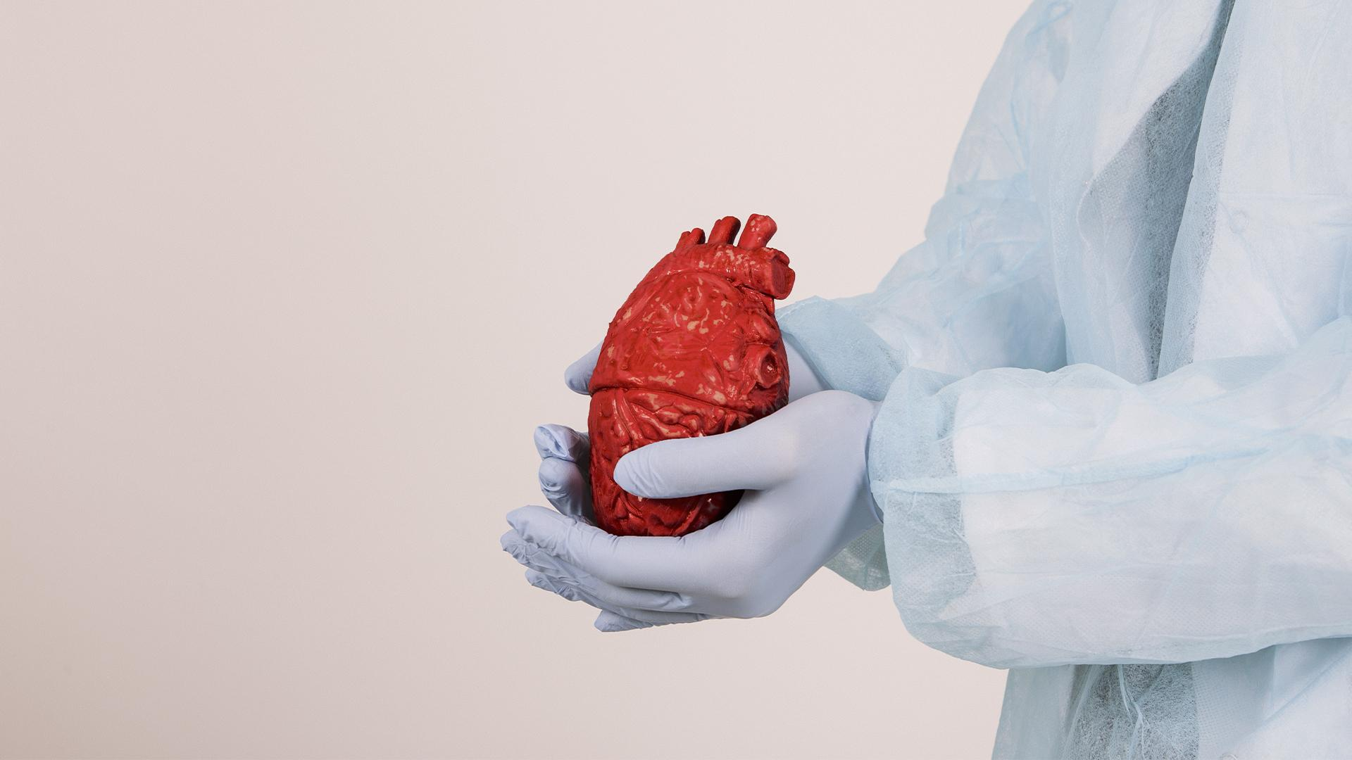
Thank you for this great opportunity!!

